Slide 1

Functional programming in Java 8 Part 5 – Reactive Streams Specification - Introduction
Stav Alfi

Slide 2
Pre Requirements
Functional Programming in Java 8 - Part 1 - Basic Concepts & Lambdas
Functional Programming in Java 8 - Part 3 - Java Streams – Introduction
Functional Programming in Java 8 - Part 4 - Optional and Primitive Streams

Slide 3
Agenda
Step back:
Stateless, Immutable, Pure function and Side effects
Functional Interfaces Family
Declarative pipelines
Native solutions for declarative & Async code in Java
Reactive Streams - Introduction
Project Reactor - Introduction
Spring Reactive Web - Introduction

Slide 4
Step back
Immutable object
Stateless method
Side effects
Pure function
Side effects & Pure functions advantages
Declarative pipelines
Native solutions for declarative & Async code in Java

Slide 5
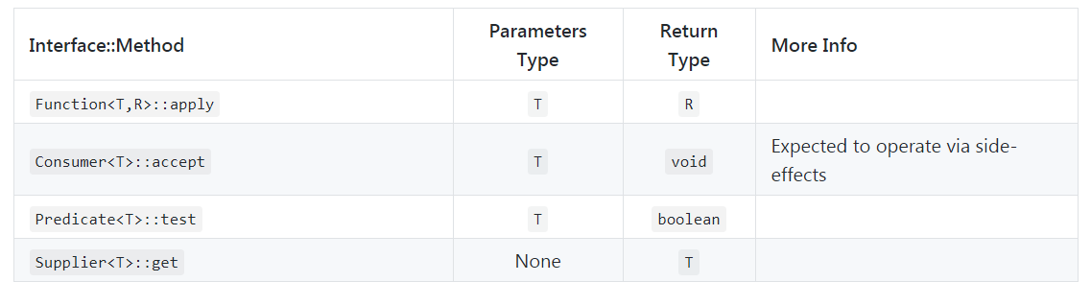
Step back - Functional Interfaces Family

Slide 6
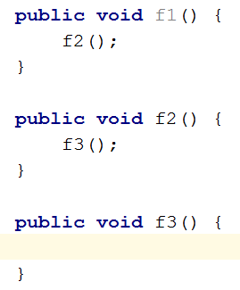
Declarative Pipelines – Why?

Slide 7
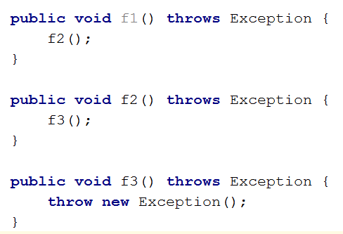
Declarative Pipelines – Why?
Side effects!!!!
Why????
Side effects!!!! Why????
Side effects!!!!

Slide 8
Declarative Pipelines – Why?
Tests:
Separate tests
If not - extremely harder and time-consuming!
Readability
Expansion

Slide 9
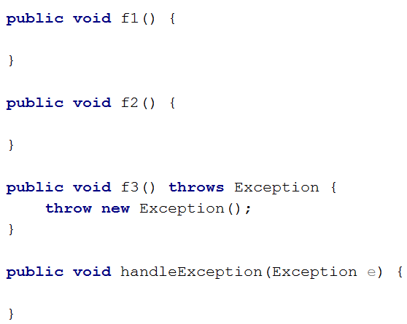
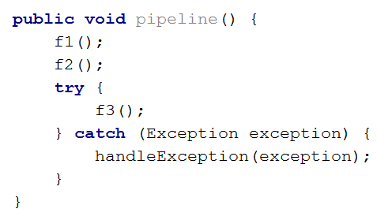
Declarative Pipelines – Basic solution

Slide 10
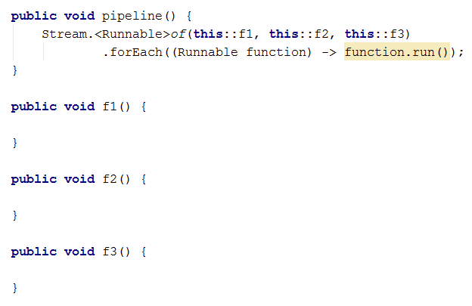
Declarative Pipelines – Native solution

Slide 11
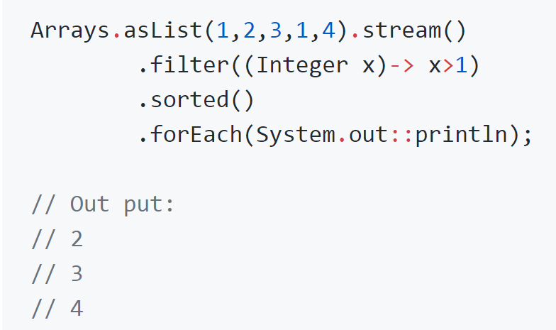
Declarative Pipelines – Native solutions

Slide 12
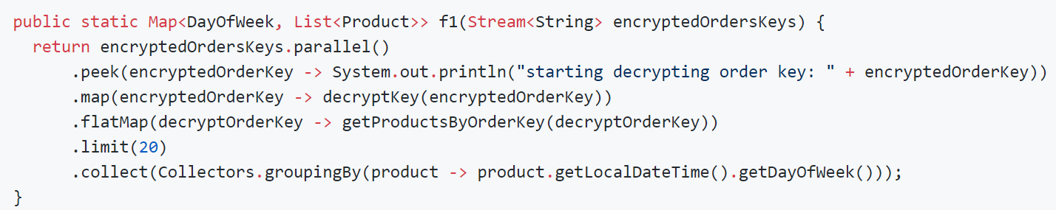
Declarative Pipelines – Why?

Slide 13
Async vs Sync operations
Synchronous operation == Blocking operation == Invoking a method & waiting until that method is finished.
Async operation != Non blocking operation
Invoking a method & Letting it complete while I’m not getting blocked.
Invoking a method & Asking if it can complete now.

Slide 14
Native solutions for Async streams in Java
Amount of elements/Is Async | Synchronous | Async
0...1 | Future Optional | CompletableFuture
0…Infinity | Java Streams | Reactive Streams
Session 4
Session 5
Today
Session 3

Slide 15
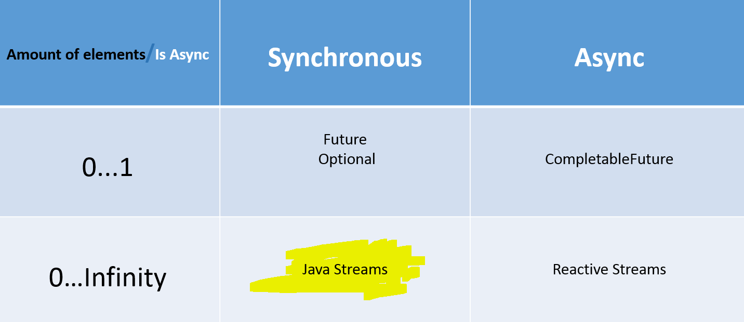
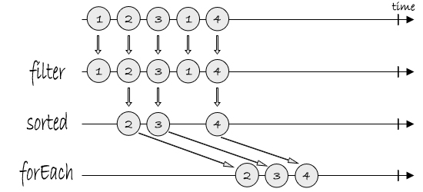
Native solutions - Java Streams are Blocking

Slide 16
Native solutions - Java Streams
Java streams are Pull based == I ask for the elements while I KNOW they are already exist.

Slide 17
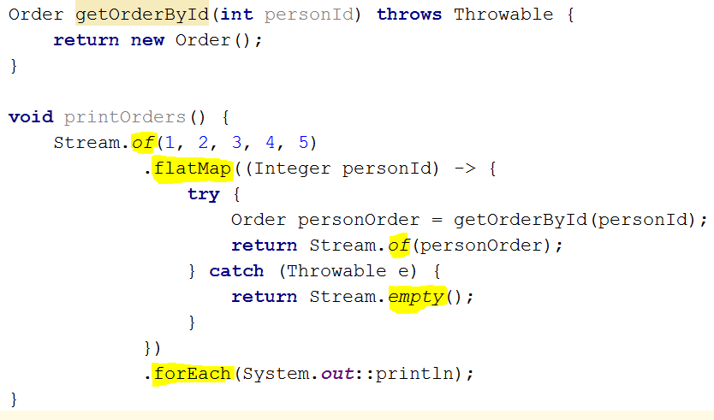
Native solutions - Java Streams` error handling

Slide 18
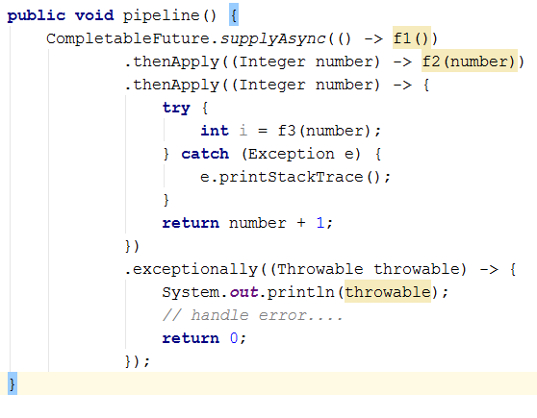
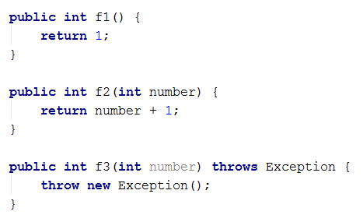
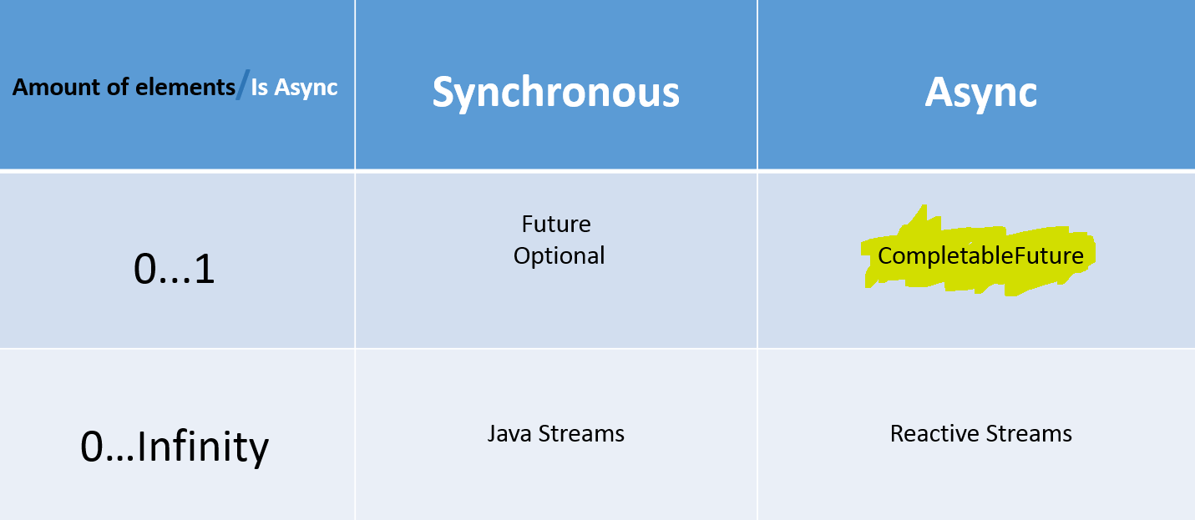
Native solutions – CompletableFuture error handling

Slide 19
Native solutions – CompletableFuture conclusion
Handles only unchecked exceptions
Handles only 0…1 elements in the streams
How can I handle [0…Infinite] amount of elements asynchronously?

Slide 20

Reactive Streams - Introduction
But first, 5 min break ☺

Slide 21
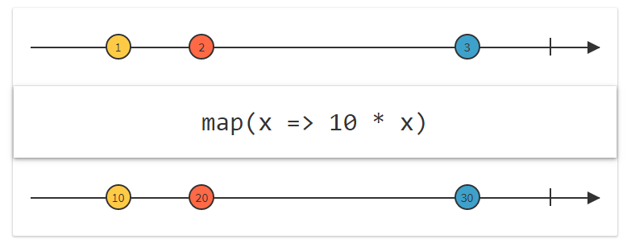
Reactive Streams - Marble diagrams

Slide 22
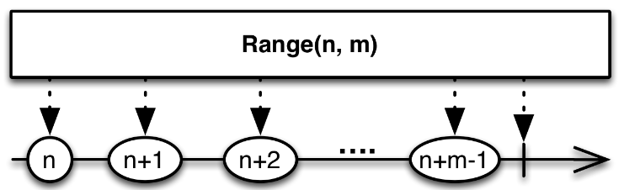
Reactive Streams - Marble diagrams

Slide 23
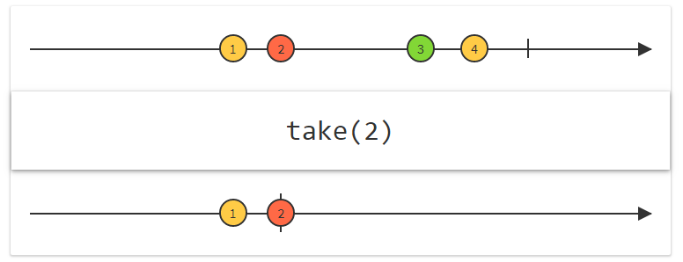
Reactive Streams - Marble diagrams

Slide 24
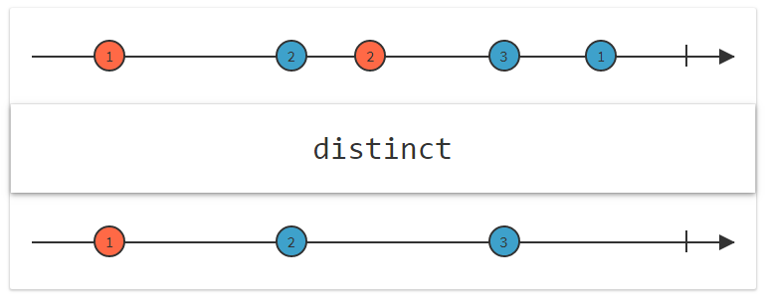
Reactive Streams - Marble diagrams

Slide 25
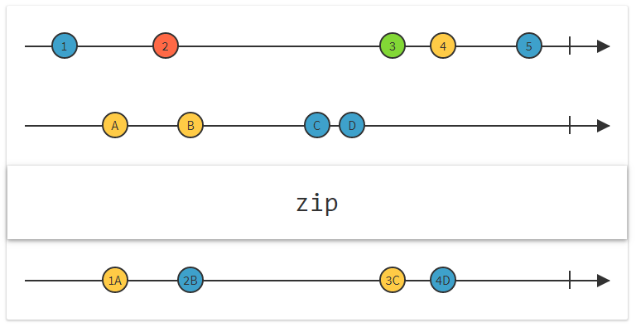
Reactive Streams - Marble diagrams

Slide 26
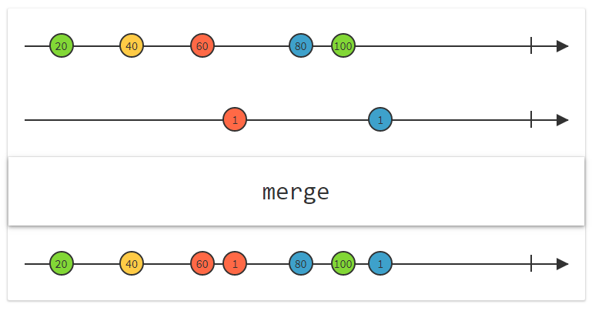
Reactive Streams - Marble diagrams

Slide 27
http://rxmarbles.com/#buffer
http://rxmarbles.com/#repeat
http://rxmarbles.com/#distinctUntilChange

Slide 28
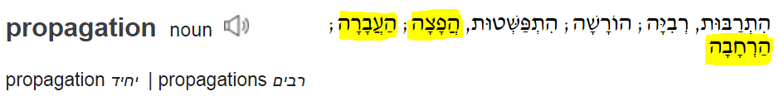
Reactive programming– What is it?
Reactive programming is a declarative programming paradigm concerned with data streams and the propagation of change. Reactive programs maintain a continuous interaction with their environment, but at a speed which is determined by the environment

Slide 29
Reactive Streams– What is it?
Reactive Streams is an initiative to provide a standard for asynchronous stream processing with non-blocking back pressure.
In short, it is a standard (Java 9) set of rules to write reactive programming code for the JVM and JavaScript.

Slide 30
Reactive Streams – API
Publisher - sends [0…Infinite] elements to everyone who want.
Subscriber - Ask for [0…Infinite] elements from a publisher.
Subscription - Used by the subscriber for requesting [N] elements or cancel the stream.
Processor - Is a Subscriber and a publisher == He get and send [0…Infinite] elements.

Slide 31
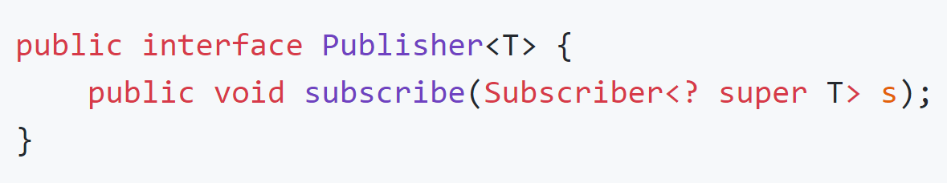
Reactive Streams - Publisher

Slide 32
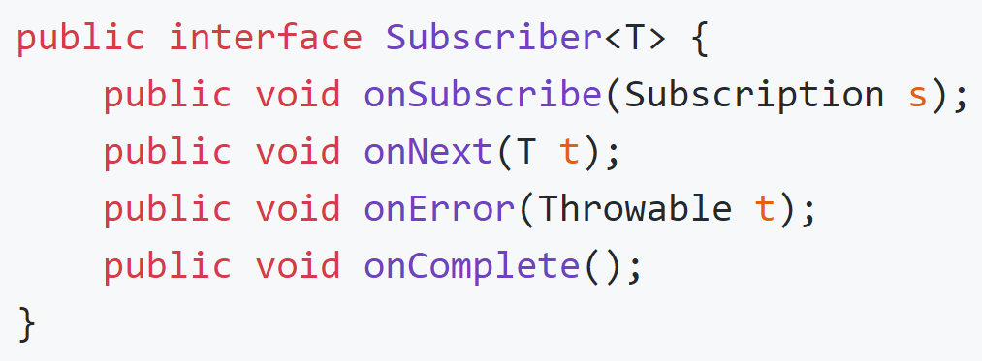

Reactive Streams - Subscriber

Slide 33
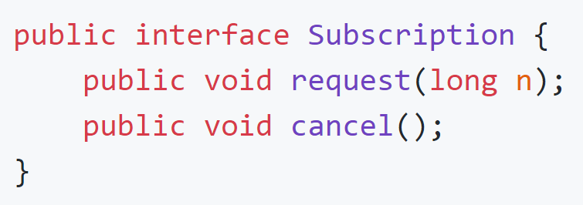
Reactive Streams - Subscription

Slide 34
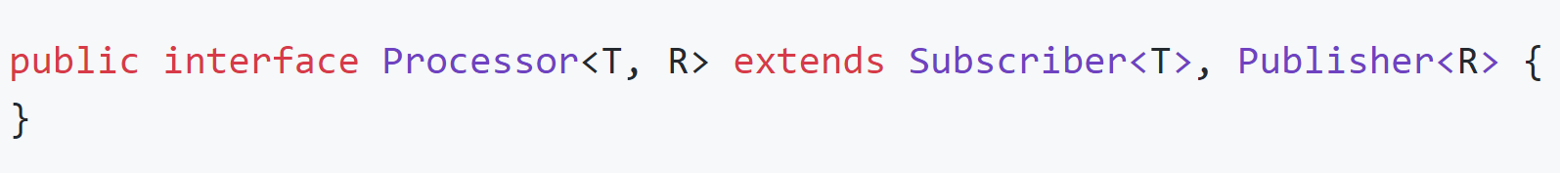
Reactive Streams - Processor

Slide 35
Reactive Streams Specification
http://www.reactive-streams.org/
https://github.com/reactive-streams/reactive-streams-jvm/blob/v1.0.2/README.md
http://reactivex.io/

Slide 36
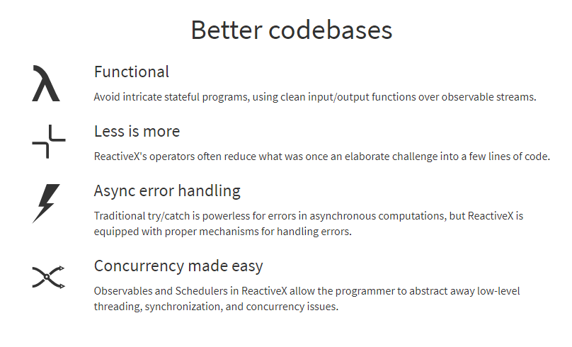
Project Reactor - Introduction
But first, 5 min break ☺

Slide 37
Project Reactor - Introduction
Reactor is a fully non-blocking reactive programming foundation for the JVM, which supports backpressure.
It implements the Reactive Streams specification.

Slide 38
Project Reactor - Introduction
Amount of elements/Is Async | Synchronous | Async
0...1 | Mono<T> | Mono<T>
0…Infinity | Flux<T> | Flux<T>
Session 5

Slide 39
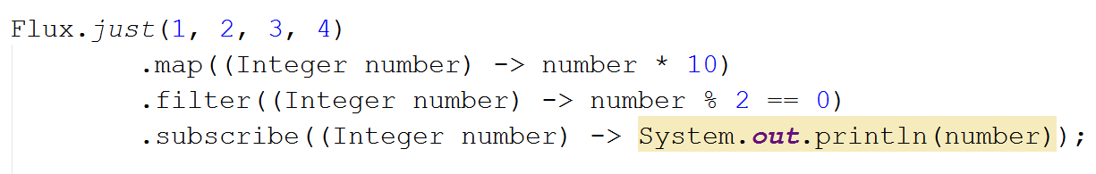
Project Reactor - Code
Publisher - sends elements
Subscriber - Ask for elements
Subscription - Used by the subscriber for requesting [N] elements or cancel the stream.
Processor – Subscriber + Publisher

Slide 40
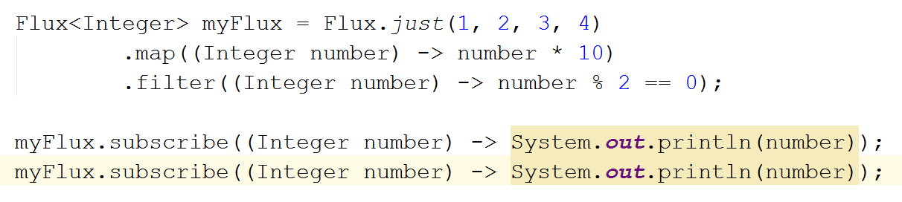
Project Reactor - Code
Publisher - sends elements
Subscriber - Ask for elements
Subscription - Used by the subscriber for requesting [N] elements or cancel the stream.
Processor – Subscriber + Publisher
Streams are by default cold & blocking

Slide 41
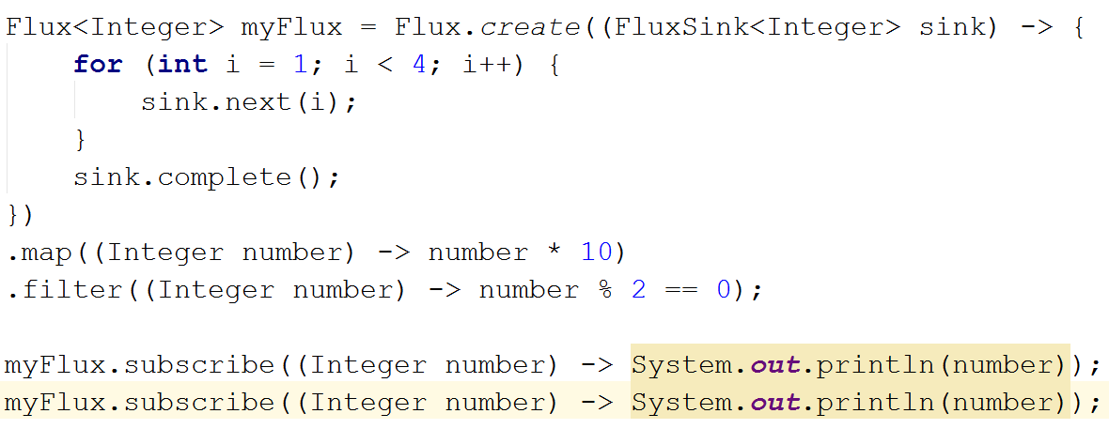
Project Reactor - Code
Streams are by default cold & blocking

Slide 42
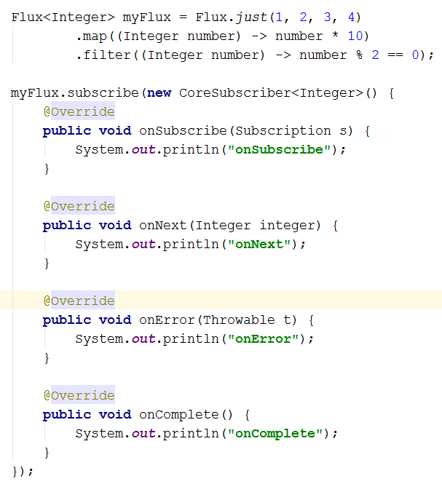

Project Reactor - Code
Streams are by default cold & blocking

Slide 43
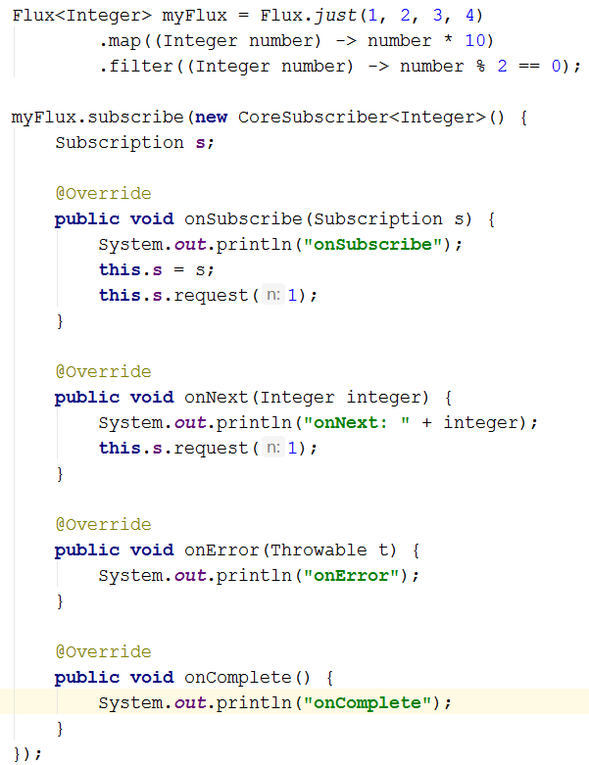
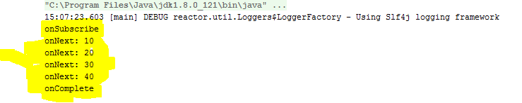
Project Reactor - Code
Streams are by default cold & blocking

Slide 44
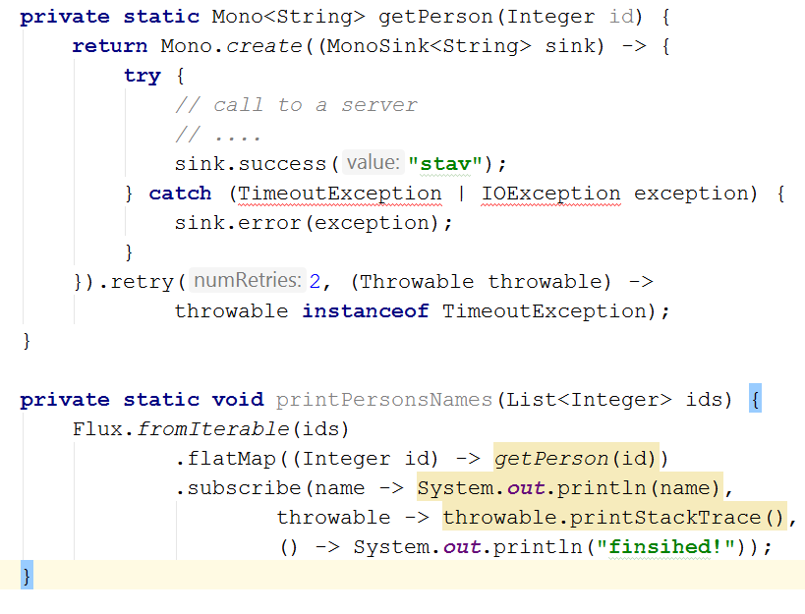
Project Reactor - Code
Streams are by default cold & blocking

Slide 45

Project Reactor – What have we seen
Async
Sync
Cold Streams

Slide 46
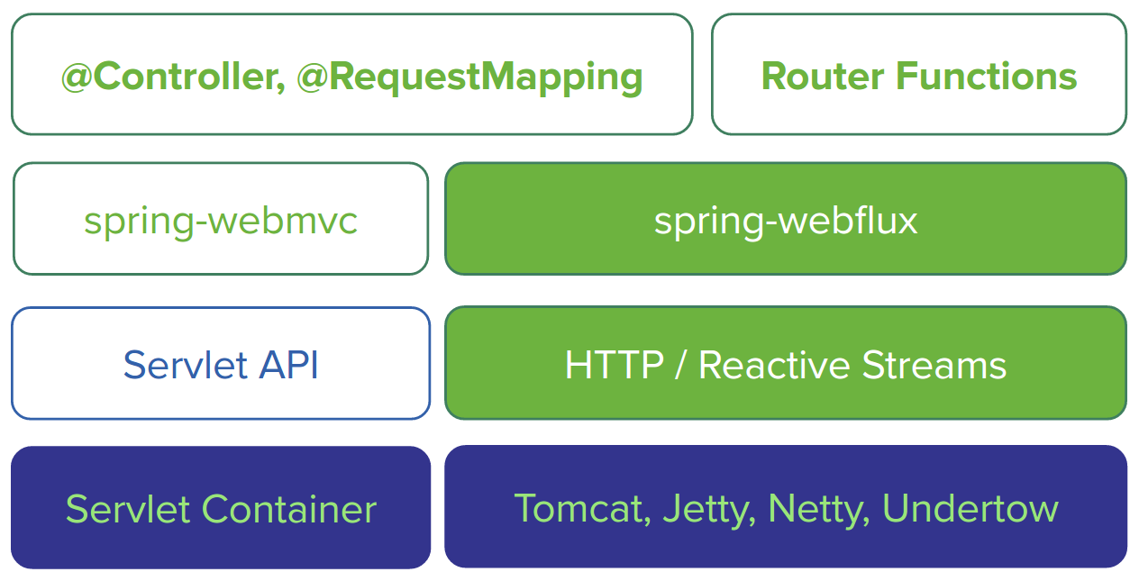
Spring Reactive Web - Introduction
But first, 5 min break ☺

Slide 47
Spring Reactive Web - Introduction
The greater the latency per call, or the interdependency among calls, the more dramatic the benefits.

